Slide 1
The Significant Side Effects of Cheating on Programming Assignments
Arup Guha
dmarino@cs.ucf.edu
4/14/2016

Slide 2

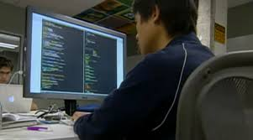
Choices Students Make
Go out and have fun
Debug Code for 10 hours

Slide 3
Consequences
Partying Student
Diligent Student
Thinks he/she can cram information before exam and be okay
Doesn’t realize that the lack of practice significantly affects ability to write proper code and to debug code.
Thinks copying code for the assignment isn’t a big deal.
Learns how and why behind fundamental topics in computer science
Has developed brain patterns that allow for creative problem solving and future learning.

Slide 4

Who writes better code upon graduation?
http://theduckrabbit.com/2015/10/the-superstar-of-sport-coding/

Slide 5

Biggest Side Effect of Graduating Poor Coders
Buggy Software has caused billions of dollars of loss and loss of life.
  Therac-25 (1985) – 6 large radiation overdoses
  Patriot Missile Accident (1991) – 28 deaths
  Ariane-5 (1996) – cost $254 million
  Mars Climate Orbiter (1998) – cost $327.6 million
  North East Blackout (2003) - $10 billion and 11 lives

Slide 6

Other side effects
Grades are no longer fair.
Grades no longer indicate ability.
The entire degree is devalued.

